Slide 1
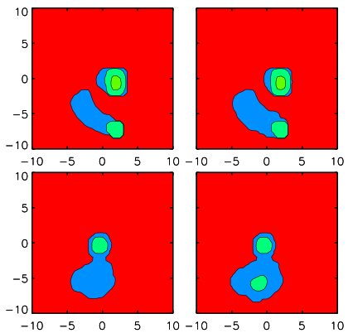
Particle Density
Particle Energy
Fig. 1
V_{x}
V_{x}
V_{y}
V_{y}
V_{z}
V_{z}
Notes:
Real Low Shock Beam formation

Slide 2
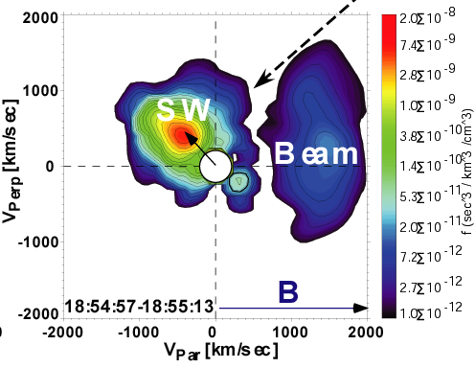

Slide 3
Particle Density
Particle Energy
Fig. 2
V_{x}
V_{x}
V_{y}
V_{y}
V_{z}
V_{z}
Notes:
Real Low Shock Beam formation

Slide 4
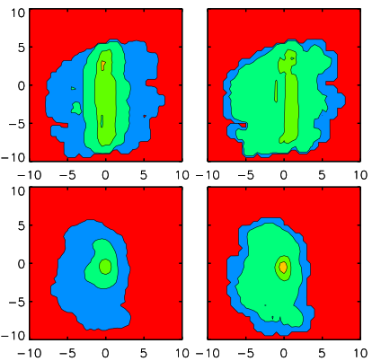
Particle Density
Particle Energy
Fig. 3
V_{x}
V_{x}
V_{y}
V_{y}
V_{z}
V_{z}
Notes:
Real Low shock downstream

Slide 5
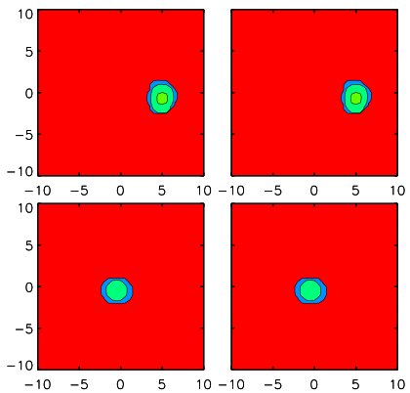
Particle Density
Particle Energy
Fig. 4
V_{x}
V_{x}
V_{y}
V_{y}
V_{z}
V_{z}
Notes:
High Shock Upstream

Slide 6
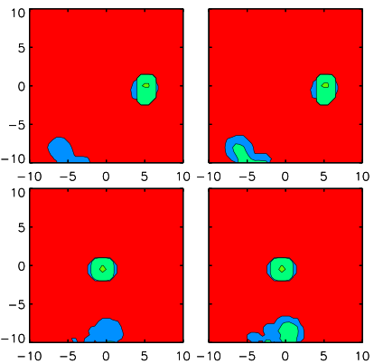
Particle Density
Particle Energy
Fig. 5
V_{x}
V_{x}
V_{y}
V_{y}
V_{z}
V_{z}
Notes:
High Shock Upstream Beam 1

Slide 7
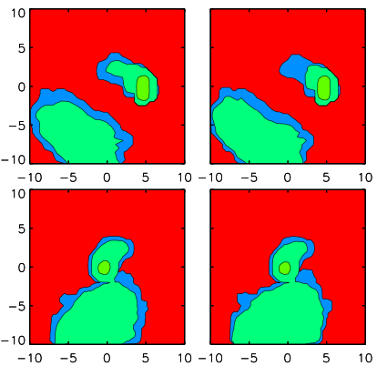
Particle Density
Particle Energy
Fig. 6
V_{x}
V_{x}
V_{y}
V_{y}
V_{z}
V_{z}
Notes:
High Shock Upstream Beam 2

Slide 8
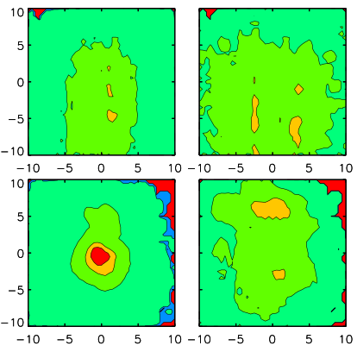
Particle Density
Particle Energy
Fig. 7
V_{x}
V_{x}
V_{y}
V_{y}
V_{z}
V_{z}
Notes:
High Shock Upstream Beam 2

Slide 9
Particle Density
Particle Energy
Vx X Vy
Vx X Vy
Vz X Vy
Vz X Vy

Slide 10
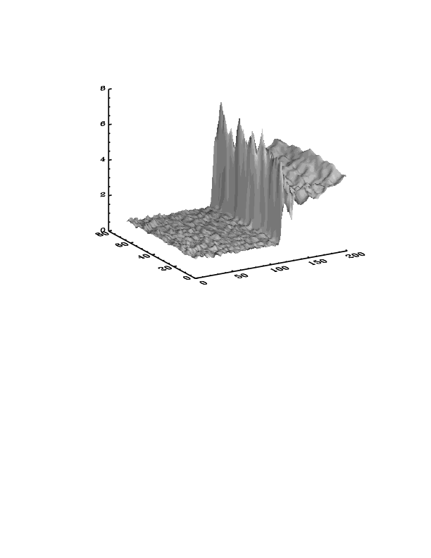
High Speed Shock Example

Slide 11
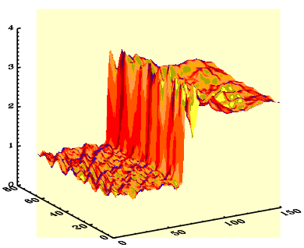
Low Speed Shock Example

Slide 12
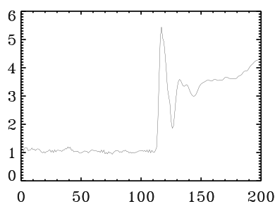
High Speed Shock Example
B
Fig. 4
Fig. 5 Fig. 6 Fig. 7
X

Slide 13
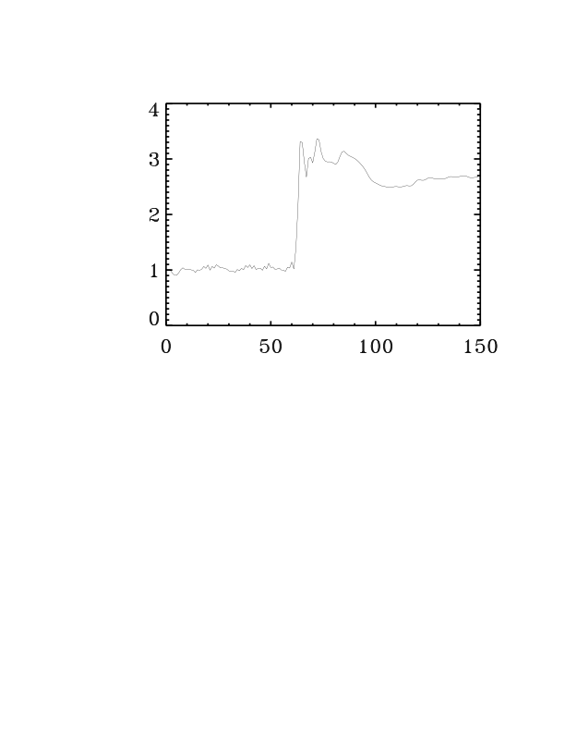
Low Speed Shock Example
B
Fig. 1 Fig. 2 Fig. 3
X

Slide 14
Ion dynamics
Electrons
dv_{i}
V_{i} x B
massless, quasi-neutral fluid
m_{i} = q_{i} (E + )
dt
c
en_{e} = q_{i}n_{i}
x_{n+1}(i) = x_{n}(i)+v_{n+1/2}(i)Δt
-momentum eqn.
d
V_{e} x B
n_{e}m_{e}V_{e} = 0 = -en_{e}(E + ) -∇*P_{e}
dt
c
move particles & collect
moments (ρ_{i}=q_{i}n_{i}, J=q_{i}n_{i}V_{i})
on grid
- closure
Scalar pressure p_{e} = n_{e}T_{e},
T_{e} = const, or adiabatic

Slide 15
Electromagnetic fields
- Faraday’s law
∂B
= -c (∇× E)
∂t
- Ampere’s law (low-freq. Approx)
4π
4π
∇× B = J = q_{i}n_{i}(V_{i} – V_{e})
c
c
- E – field from electron momentum equation
V_{i} x B
∇p_{e}
B x ( ∇ x B)
E = - - -
c
q_{i}n_{i}
4πq_{i}n_{i}

